Slide 1
HUMAN INTERACTIONS WITH ON-BOARD SENSORS OF NEXT GENERATION OF AIRCRAFTS
A BRIEF RESEARCH
An introduction about the research

Slide 2
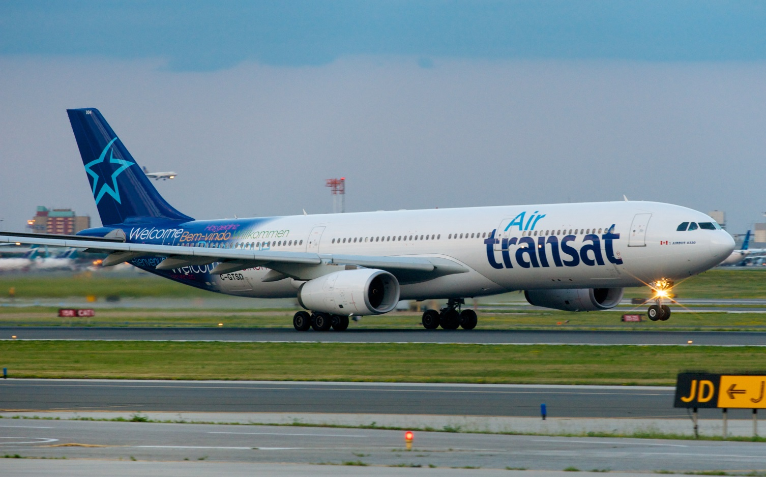
Example - 1
Notes:
Air Transat Flight 236

Slide 3
Air Transat Flight 236
On the night of 24th August, 2001, an Italy based Canadian charter company called Air Transat was operating one of its Airbus A330 from Toronto to Lisbon
At halfway, the flight’s warning system started showing an unusual warning, ‘oil pressure low at engine number 1’
The pilots got puzzled and blindly ignored the warning thinking it could be a computer error

Slide 4
Air Transat Flight 236
After 30 minutes, the on-board warning system started showing another confusing error, ‘fuel quantity low at engine 1’
One of the experienced captain of Air Transat, Captain Robert Piche blindly turned on the fuel cross-feed valve switch which made the fuel flow from the right main tank to the left main tank
Unknowing to the pilots, there was a major fuel leak at engine 1

Slide 5
Air Transat Flight 236
Midway in the Atlantic ocean, still 136 nm to go, both the engines of Air Transat Flight 236 shut down.

Slide 6
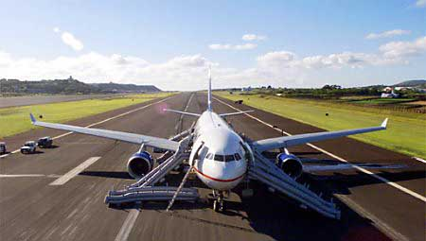
Air Transat Flight 236
But Captain Piche managed to land the plane in a military base near Madrid after facing some unusual problems.

Slide 7
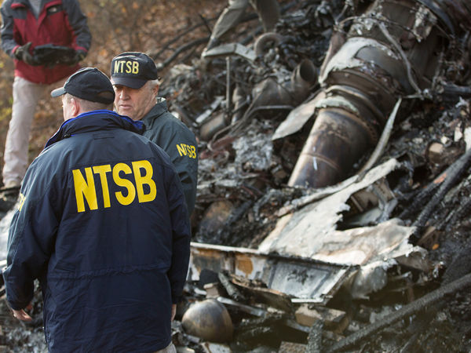
After the report of every Air Crash Investigation, the NTSB (National Transportation Safety Board) makes some changes in the International Aviation Rules, standard procedures and checklists according to the reason of crash.

Slide 8
Example - 2
On the morning of February 25th 2009, Turkish Airlines Flight 1951 became the 1st plane to crash at Amsterdam Schiphol International Airport in more than 10 years.
The crash involved the word’s most popular aircraft ‘The State of the Art’ Boeing 737.
Turkish Airlines Flight 1951 was preparing to land at Schiphol Airport. But the landing turned into a catastrophe.

Slide 9
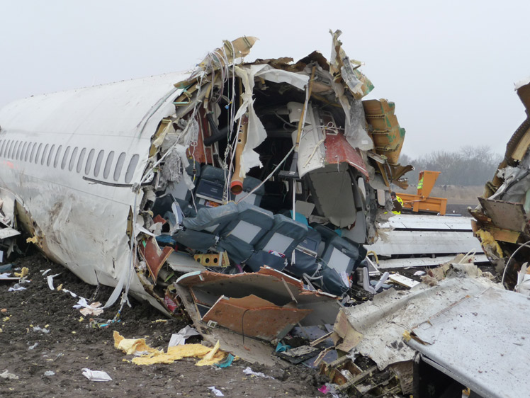
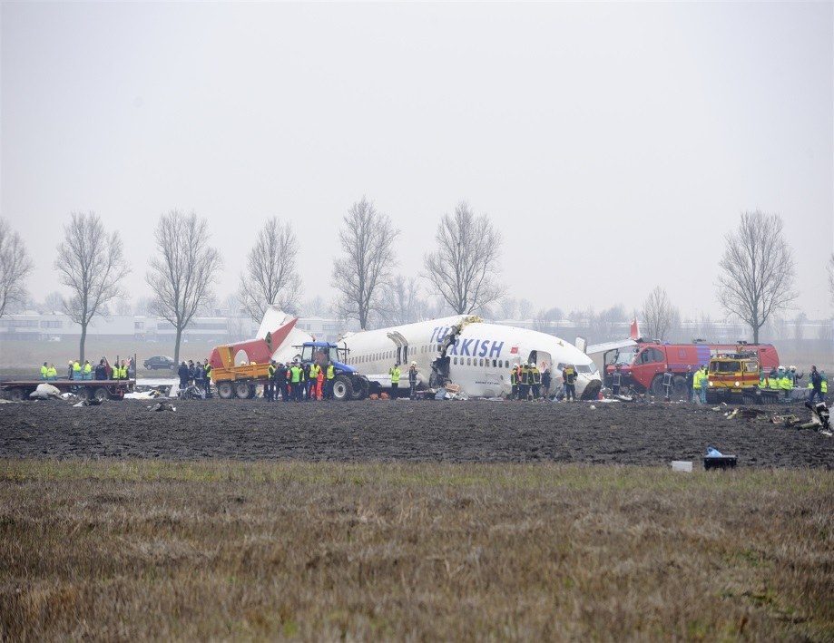
Turkish Airlines Flight 1951

Slide 10
Turkish Airlines Flight 1951
The reason of the crash is, one of the instruments called ‘radio altimeter’ which measures the altitude from the ground was showing that the plane is already in the ground!
And the most terrible thing is Captain Hssan Arisan knew that!

Slide 11
Turkish Airlines Flight 1951
The whole concept of airline safety is based on the idea that they may face any number of failures and should still be able to arrive safely. The radio altimeter is just an instrument. How can its failure be responsible for the plane crash?
Flight data recorder revels that the plane’s throttle was in idle mode at the time of hitting the ground.

Slide 12
Turkish Airlines Flight 1951
Investigators determined that Turkish Airlines Flight 1951 crashed mainly because the pilots did not recognise the consequences of the warnings they were getting.
Because the plane was giving a lot of warnings regarding stuff such as landing gear configuration.

Slide 13
This is not the first plane to crash due to the misinterpretation of the plane’s message by the crew
Aeroperu Flight 757
Air Fance Flight 447
British Airways Flight 38
American Airlines Flight 1420 etc. have crashed because of the same reason.
NASA is working on something called the integrated intelligent flight deck. It’s a project that helps humans to use the technology that surrounds them in the cockpit. Some of the researches are finding the technology that shouldn’t replace the gauges but work with them.

Slide 14
We have such an advanced technology as even at zero visibility, the pilots can land their plane safely (Using ILS).
Then why are the planes crashing? Is it because of human errors?

Slide 15
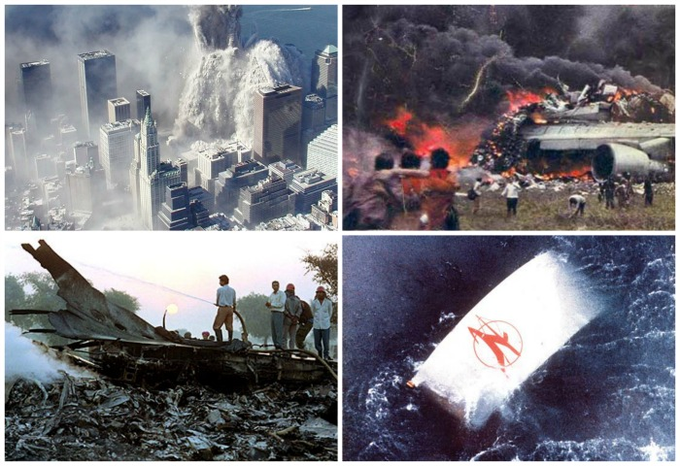
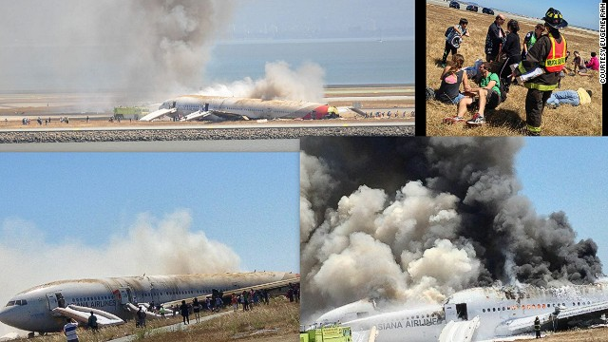

Slide 16
The Ultimate Million Dollar Question is…..
Can’t We Fix This????????

Slide 17
If we look at the survey made by NTSB in 2011, 85% of aircrafts have crashed because of pilot errors. 10% is for mechanical failures, 4% is for instrumental failures and remaining 1% is because of some other reasons like terrorism, weather etc.

Slide 18
A long range wide body jet A350 by Airbus has newly been launched. Here Airbus has made several changes in its instruments. The pilots need to learn programming languages to communicate better and to understand consequences pertaining the flight.

Slide 19
This research is all about the warnings, ATC, FMC (Flight Management Computer) and Central Digital Panel/Tab of next generation of aircrafts.

